Slide 1



MODERN DAY SLAVERY & HUMAN TRAFFICKING
DETECTIVE SERGEANT 947 MANDI VENN
Modern Day Slavery & Human Trafficking

Slide 2

WHAT IS MODERN DAY SLAVERY?
HUMAN TRAFFICKING INVOLVES:
Recruiting vulnerable children and adults
Moving them to another place, often another country
Using threats, force or other form of coercion or deception to make them do something against their will
Exploiting them to make money or provide services for their traffickers or others
Modern Day Slavery & Human Trafficking
Notes:
Talk about “into UK”, “out of UK” & “around the UK” – from one area or city to another – known as Internal Trafficking or could even be from one room or floor to another.
Usually for those coming into the country, it is for a job they have applied for but turns out to be something completely different when they arrive.
While many organisations have different work streams or departments, the traffickers have a person they regard as a commodity, who they use and abuse at will. They do not simply categorise any single facet, but will make use of the victim however they see fit.
It is a fact that traffickers will ‘coach’ victims not to engage with ‘the Authorities’ – Police and Social Services. The fact that many victims come from under developed areas where corruption is rife, is often used by the traffickers to ensure that they are reluctant to engage with Police or SSD.

Slide 3
DIFFERENCES – TRAFFICKING AND SMUGGLING?
HUMAN TRAFFICKING
The movement of a person from one place to another into conditions of exploitation, using deception, coercion, the abuse of power or the abuse of someone’s vulnerability.
PEOPLE SMUGGLING
The procurement, in order to obtain, directly or indirectly, a financial or other material benefit, of illegal entry of a person into a State Party of which the person is not a national or permanent resident.
Modern Day Slavery & Human Trafficking
Notes:
SMUGGLING = People being smuggled as illegal migrants have usually consented to being smuggled. The relationship between an illegal migrant and a people smuggler is a commercial transaction which ends on completion of the journey.
This will be with the victims knowledge and consent. OFFENCE AGAINST THE STATE.
TRAFFICKING = Victims of trafficking have not consented, or the consent they did give is rendered meaningless by the actions of the traffickers, e.g. DECEPPTION – COERCION – ABUSE OF POWER.
However, for those who have been trafficked the very purpose of their journey is to put them into an exploitation situation from which the traffickers can profit.

Slide 4
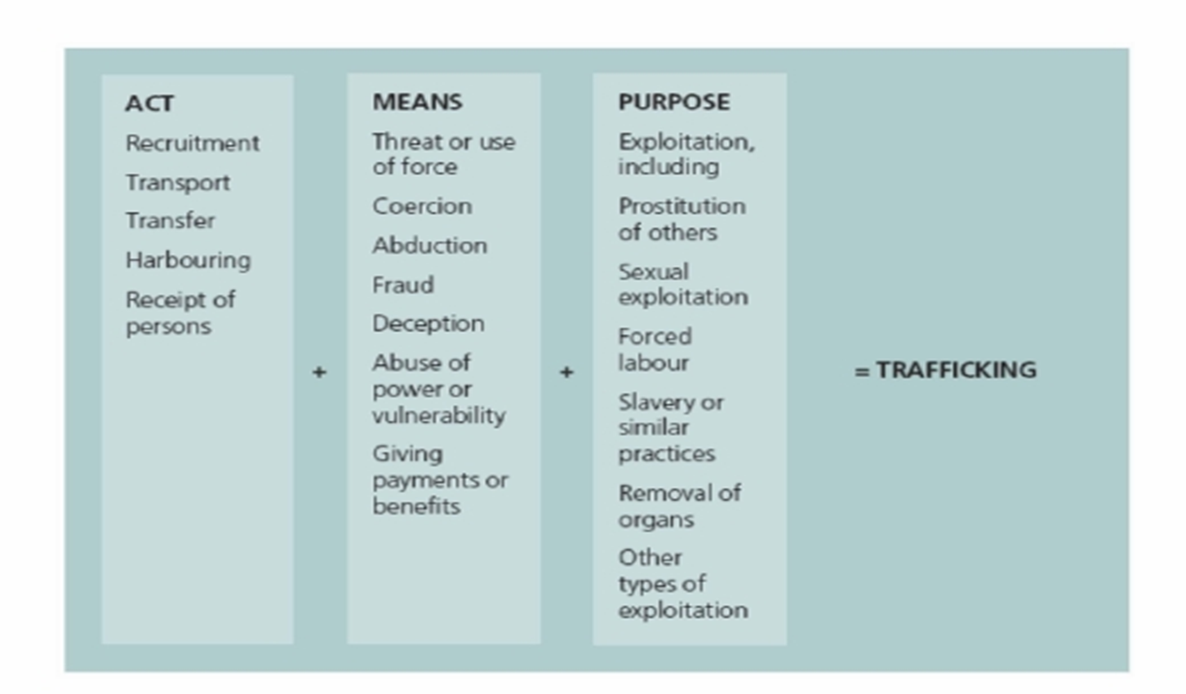
THREE ELEMENTS
Modern Day Slavery & Human Trafficking
Notes:
Smuggling
People being smuggled as illegal migrants have usually consented to being smuggled. The relationship between an illegal migrant and a people smuggler is a commercial transaction which ends on completion of the journey.
Human trafficking
Victims of trafficking have not consented, or the consent they did give is rendered meaningless by the actions of the traffickers, e.g. deception. However, for those who have been trafficked the very purpose of their journey is to put them into an exploitation situation from which the traffickers can profit. Human trafficking can be categorised as sexual exploitation (rape and prostitution) and non-sexual exploitation (begging, forced labour, domestic servitude, cannabis cultivation, pick-pocketing, human organ transplant, slavery)

Slide 5
TYPES OF EXPLOITATION
These are fairly wide ranging and often include the following types of conduct:
Sexual Exploitation
Forced labour
Criminal Exploitation/County Lines/Cuckooing
Domestic Servitude
Organ harvesting
Child relating crime such as sexual exploitation, Illegal drug dealing, organised theft and forced begging
Modern Day Slavery & Human Trafficking
Notes:
Sexual - frequently through prostitution where victims are placed into off-street brothels, forced to see many clients, and receive either little or no money.
Forced labour - where victims are forced to work very long hours and hand over all of their wages to their traffickers or controllers, e.g. domestic situations as nannies or maids, sweatshop factories, construction sites, farm work, paving/ tarmacking
Criminal – drugs, cannabis farming, organised crime, begging, benefit fraud, sshoplifting/Theft, Credit card/ATM fraud, Selling Stolen Goods, DVD Pirating and Sales – Section 45 defence can be used for some criminal offences if HT / MDS disclosed – seek advice CPS
Domestic Servitude - victims who live and work in households where they are forced to work through threats of serious harm and physical and sexual assaults.
Enabling others to acquire benefit - this can include but is not restricted to money from state financial assistance such as child benefit or unemployment benefit
Organ harvesting - where victims are trafficked in order to sell their body parts and organs for transplant; eggs, kidneys, eyes (China)
EGGS IN THIS COUNTRY – NOT ORGAN. Eyes China 300,000 await cornea transplants only 10,000 operations – 6 year old child drugged kidnapped eyes gouged out and corneas taken - Nepal nicknamed Kidney bank
Children - children are amongst the most vulnerable victims; sometimes they are sold into forced labour or domestic work through debt bondage by family members where they are vulnerable to sexual or physical abuse.

Slide 6
SOME SIGNS THAT SOC TAKING PLACE
Cash being used – Why Cash/ Why Cheap
People interpreting for others
Not having the correct equipment for the job
Houses of Multiple Occupation/ Lots of Visitors
Visible injuries often left untreated
No freedom of movement or speech
Unable to give an address or identify where they live
No documents/ID/Papers/Bank information
Modern Day Slavery & Human Trafficking
Notes:
Hand Car Washes operate in Cash, Letting Properties Cash deposits – used for Cannabis cultivation/pop up brothels/ Cars being hired for county lines
Abusers acting on their behalf setting up national insurance numbers/bank accounts
Lots of people living in one location – often taken to work (hotbedding) and lots of visitors cuckoo’d property
Workers not having correct tools for jobs / often dropped early picked up late no access to phone/food etc

Slide 7
WORK WITHIN THE MDS TEAM
Developed Relationships with Partner Agencies
Joint Working on Operation Spider, Operation Candy, Operation Aphrodite
Created procedures relating to Duty to Notify (National Referral Mechanism) in Gwent Police
Trained over 1,300 people on MDS/HT Awareness
Intelligence /Crimes/Duty to Notify/Arrests/Referrals all increased within Gwent Police
Modern Day Slavery & Human Trafficking
Notes:
Cant work alone need Partnership approach to all we do – Hand Car wash Operation DWP/Immigration/Trading Standards/Glaa/HMRC/Water Resource Wales/National Minimum Wage Team/Health and Safety Executive, Operation Integrity Testing Hoteliers – checking if signs of CSE acknowledged and reported, Missing Persons Team do Makesafe Training. Operation working with our SEWREC /SEASS partners to look at safeguarding Sex Workers on Adult Service Websites

Slide 8
SOME FIGURES FOR GWENT
FIGURES FOR GWENT FOR 2018:-
85 Referrals received
EAST OF GWENT 60 NATIONAL REFERRAL MECHANISMS SUBMITTED
31 CHILDREN AND 29 ADULTS
WEST OF GWENT 25 NATIONAL REFERRAL MECHANISMS SUBMITTED
10 CHILDREN AND 15 ADULTS
Modern Day Slavery & Human Trafficking
Notes:
Figures for Gwent – split East / West - 41 children and 44 adults exploited. More children exploited in East -

Slide 9

CASE STUDY
Modern Day Slavery & Human Trafficking
Notes:
4 Romanians come to Gwent as a result of advert - £35 per day (£12 only in Romania) work for 3 weeks 12 hours per day no money, survive by hoovering up coins in cars emptying hoover bag out end of day and using money to pay for whoops loaf, no heating or hot water in property, winter conditions, rat infested property

Slide 10

VICTIM STATEMENTS
Modern Day Slavery & Human Trafficking
Notes:
As a result of partnership work Sex worker who made disclosures to Team regarding Trafficking and Sexual Offences, ongoing investigation

Slide 11

VICTIM STATEMENTS
Modern Day Slavery & Human Trafficking
Notes:
Our Romanian 4 – Ongoing investigation

Slide 12
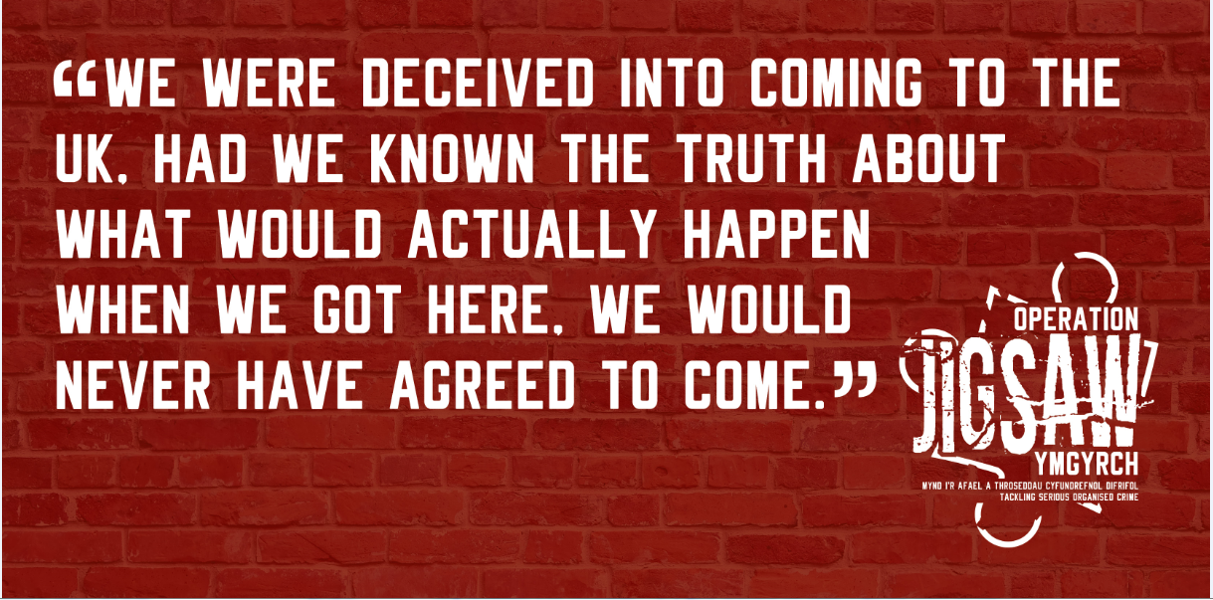
VICTIM STATEMENTS
Modern Day Slavery & Human Trafficking
Notes:
Further men come to work at Hand Car Washes

Slide 13
THANK YOU – ANY QUESTIONS
MODERN DAY SLAVERY/HUMAN TRAFFICKING TEAM
DETECTIVE SERGEANT 947 MANDI VENN
DETECTIVE CONSTABLE 1092 REBECCA LEWIS
POLICE CONSTABLE 690 AZINA HALL
ADVOCATE REBECCA STONE
RISCA POLICE STATION
ModernDaySlavery@Gwent.pnn.police.uk
Modern Day Slavery & Human Trafficking
Notes:
Thank you for listening – Will be around for any questions

